Slide 1

GFW
Great firewall
Yang Zhenyu
06,10,2024

Slide 2

Preface:
I remember one day during a computer class in junior high school when Google suddenly became inaccessible. It was 2003. At that time, I read in a magazine that modifying DNS seemed to allow access to Google, but later that stopped working. In fact, it wasn't until I went abroad that I learned about the existence of the Great Firewall (GFW). I had always believed the government's narrative that Google had simply withdrawn from China. I didn't know that a "Great Firewall" was blocking our interaction with information from the outside world. It wasn't until 2016, when I traveled to Europe, that I discovered platforms like YouTube, Twitter, WhatsApp, Facebook, and even porn. All the while, we had been using imitations like Baidu (search engine), Youku, Weibo, and WeChat. I'll skip the long story and dive into the technical aspects: how this "Great Firewall" has shut China's door to the world.

Slide 3
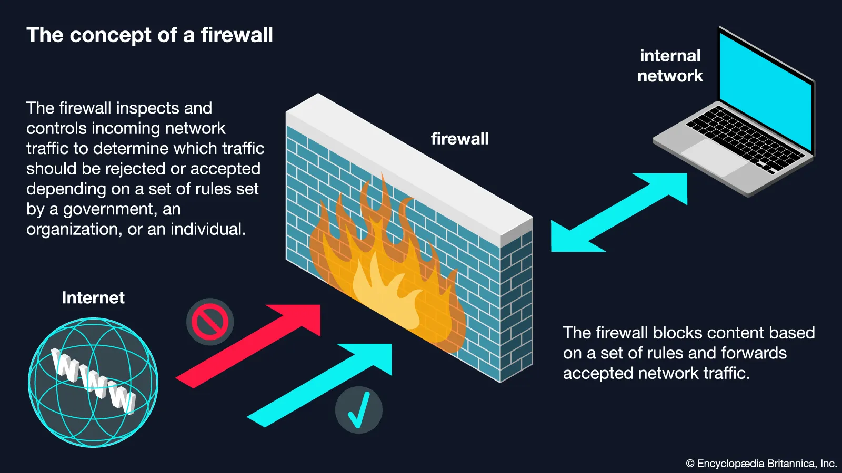
WhAT IS gfw
The Great Firewall (GFW) is a distributed intrusion detection system, not strictly a firewall in the technical sense. It doesn't inspect every IP packet entering or exiting the country. As an intrusion detection system, GFW treats every attempt to access Facebook as an intrusion and responds by resetting the connection. Detection occurs in two ways: human detection and machine detection.
Reference: https://www.britannica.com/topic/Great-Firewall

Slide 4
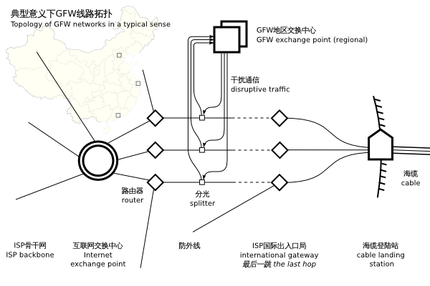
Beijing
Shanghai
Guangzhou
Reference:https://en.wikipedia.org/wiki/Great_Firewall

Slide 5
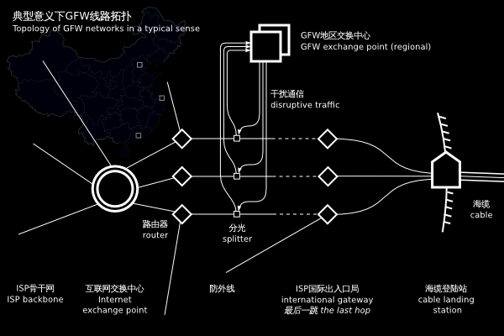
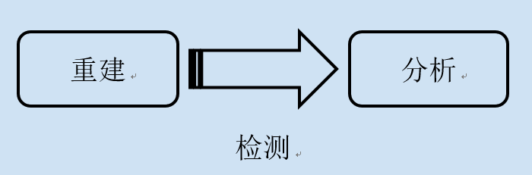
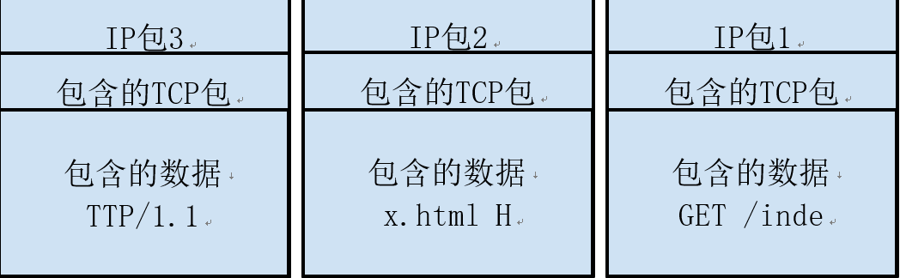
The Great Firewall (GFW) listens to network traffic by capturing IP packets, reconstructing them into complete byte streams. It then analyzes the application protocols (e.g., HTTP) in the streams to detect and block undesirable content. The exact deployment method of the GFW is unknown, but it is speculated that it uses a "splitting" technique alongside the country's outbound routers to copy and monitor all incoming and outgoing IP traffic.
Reconstruction
Analysis
Detection
TCP packets included
TCP packets included
TCP packets included
Included date
Included date
Included date
Fibre-optic Cable

Slide 6
How it work
Currently, GFW is known to take the following measures:
DNS Spoofing (also known as DNS Pollution)
IP Blocking (IP Blacklisting)
Analyzing and identifying traffic (flow) that bypasses the firewall
Keyword filtering (sensitive words)

Slide 7
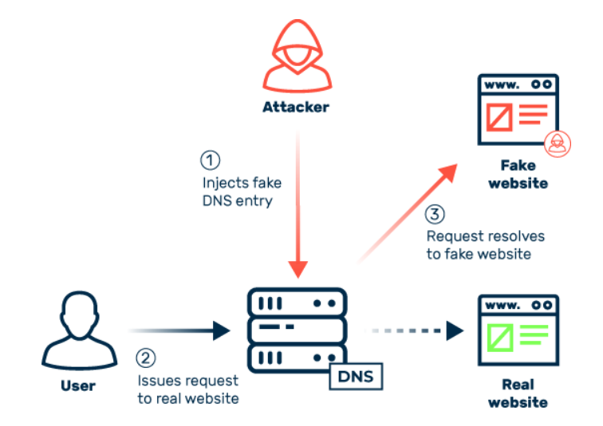
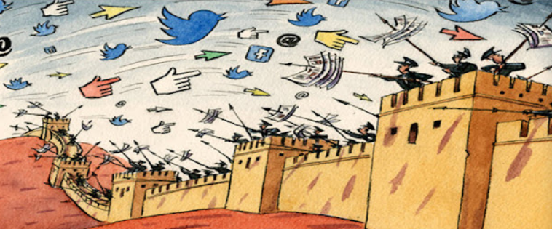
404 - page not found
DNS Spoofing (DNS Pollution):
GFW
DNS spoofing, also known as DNS cache poisoning, is when GFW forges DNS query results, causing users to receive incorrect IP addresses for the websites they're trying to visit. This technique prevents access to certain websites.

Slide 8
IP Blocking (IP Blacklisting):
GFW blocks access to websites by adding their IP addresses to a blacklist, making them inaccessible.
https://en.wikipedia.org/wiki/List_of_websites_blocked_in_mainland_China

Slide 9
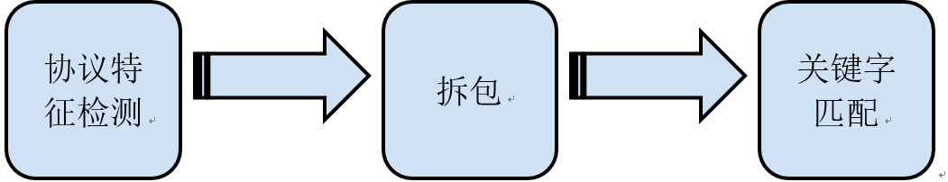

Protocol feature detection
Keyword matching
Unpacking
Sensitive Word Filtering:
GFW maintains a large and frequently updated list of sensitive words. If any of these words appear on a webpage, GFW blocks access to the content.
Reference: https://www.bbc.com/zhongwen/simp/chinese-news-40634827

Slide 10
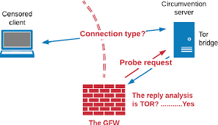
Analyzing and Identifying Traffic Bypassing the Firewall:
The first example is the automatic blocking of TOR by the GFW, which shows that the GFW makes every effort to understand the protocol itself. If a Chinese IP connects to a TOR bridge in the US, it will be detected by the GFW. Then, after about 15 minutes, the GFW will return and pretend to be a client, connecting to the bridge using the TOR protocol. If the bridge is confirmed to be part of the TOR network, that port will be blocked. After switching to a different port, you can use it for a while before it gets blocked again.
Reference: https://blog.torproject.org/blog/knock-knock-knockin-bridges-doors
https://www.semanticscholar.org/paper/The-Great-Firewall%E2%80%99s-active-probing-circumvention-Liubinskii/fb160f8eee00c1246bc1f9937dcdd20b52181386

Slide 11



How to over the Wall
1. Modify the DNS server………
2. Modify the hosts file………
3. Encrypt web proxies…….
4. Agent software:
psiphon3
。
lantern
TOR
If Psiphon uses VPN mode, all your network software will be able to circumvent the wall without any settings. If Psiphon uses proxy mode, open two ports: "8080" for HTTP proxies and "1080" for SOCKS proxies.
Lantern is characterized by its open-source and cross-platform. It's a bit like TOR in this respect. It uses HTTP proxies, and the port is "8787".
Because TOR is so famous, the GFW takes special care of it. Many of TOR's bridge trunks are blacklisted by GFW, making TOR unusable. However, since October 2014, TOR has started to build in the meek plug-in, which resurrects TOR (and can be independently networked again).
https://support.torproject.org/censorship/connecting-from-china/

Slide 12

VPN client
A VPN is also an encrypted tunnel between the local and remote VPN servers, and all data is passed through the VPN server abroad to the destination website. However, unlike proxy software, VPN software virtualizes a network card in your system. Then, the apps you surf the web (whatever type) can transfer data through this virtual network card and the VPN server.

Slide 13
Suppose you will travel to China someday. This VPN may help you go through the GFW easily.
V2ray
Trojan
Windscribe
ProtonVPN
hide.me -----
Key Highlights:
There are no data and speed limits
Free servers in 5 regions (United States East, United States West, Canada, Germany, and Netherlands)
It has military-grade encryption, leak protection, and a strict no-logs policy
Supports 1 device connection
Compatible with Windows, Mac, Android, iOS, Linux, Amazon Fire TV, Blackberry, routers, and more
Customer support is only available via email

Slide 14
Thank you for watching
Reference:
https://malicious.life/episode/episode-91/
https://www.myrasecurity.com/en/cache-poisoning/
https://ednovas.xyz/2022/06/25/gfw/#trojan
https://program-think.blogspot.com/2009/05/how-to-break-through-gfw.html#head-1
https://en.wikipedia.org/wiki/Great_Firewall

